Slide 1
An Introduction to Analysis of Means
Steve Simon

Slide 2
Introduction
1. Analysis of Means (ANOM)
Applications
Quality control
Institutional comparisons
2. Similar but different from ANOVA
3. Similar but different from control charts
4. ANOM advantages
Easy to calculate
Simple, interpretable conclusions
Notes:
An Introduction to Analysis of Means
Analysis of Means (ANOM) is an under appreciated methodology that has relevance to quality control and institutional comparisons. Unlike Analysis of Variance (ANOVA), which compares one group mean to another group mean, ANOM compares each group mean to the overall mean. The calculations in ANOM are simple and direct. ANOM also avoids many of the ambiguities inherent in the multiple comparisons used in ANOVA, and avoids a common misinterpretation about overlapping confidence intervals. This talk will illustrate the mechanics of calculating ANOM and provide context for when you should or should not use it.

Slide 3
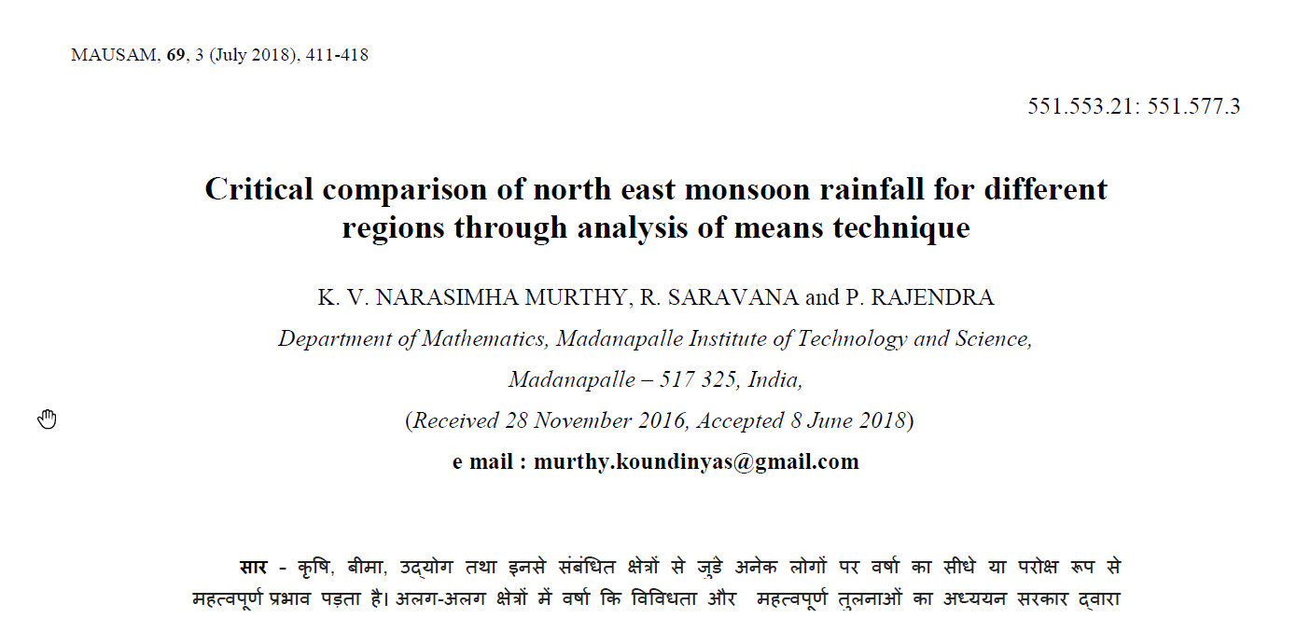
ANOM example: Monsoon distribution
Figure 1. Excerpt from research article
Notes:
While analysis of means is not the most common statistic used, it does appear in the peer-reviewed literature often enough.
Here is an example using analysis of means to look at rainfall patterns across different regions of India

Slide 4
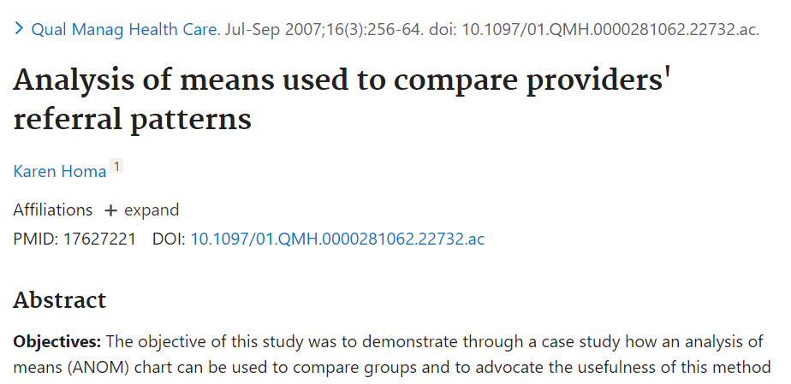
ANOM example: Physician referrals
Figure 2. Excerpt from research article
Notes:
Here is an example using analysis of means to look at referral patterns in physicians.

Slide 5

ANOM example: Laboratory assays
Figure 3. Excerpt from research article
Notes:
Here is an example using analysis of means to look at patterns among different assays for determining selenium concentrations in various biological tissues.

Slide 6

Illustrating ANOVA with strength study
Figure 4. Laboratory measurement of material strength
Notes:
To get started with analysis of means, you need an understanding of the two approaches it is similar to: analysis of variance and statistical control charts. Let’s start with analysis of variance.
Here is an example I am borrowing from a website, Statistics By Jim,
https://statisticsbyjim.com/anova/post-hoc-tests-anova/
A laboratory was studying hardness measures of some materials (arbitrarily labelled A, B, C, and D) by compressing them until they break. The researchers measured strength for 6 different pieces of each material, for a total of 24 measurements.
There are lots of different ways to measure the strength of a material. I don’t know the exact details of how they did it for this study, so I am borrowing an image of strength testing from the NASA Johnson Space Center.

Slide 7
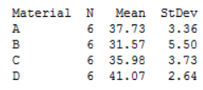
Strength study, descriptive statistics
Figure 5. Means and standard deviations from strength study
Notes:
Here are the descriptive statistics for the study. You’ll note that D has the best value and B the worst, with A and C being in between. There is a small amount of variation in the measurements within a sample, so you might ask whether the differences seen among these means could be accounted for just by sampling error or if there are some differences in the materials. If there are differences, where do they lie?

Slide 8
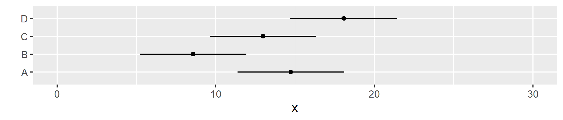
Strength study, individual confidence intervals
Figure 6. Display of individual confidence intervals
Notes:
Here are the individual confidence intervals. The interpretation of these individual intervals is tricky.
First, you can’t say anything about the intervals when they overlap.
You’d be tempted to say that there is no statistically significant difference between batches A and B, but you’d be wrong. The uncertainty associated with individual means does not translate in an additive sense to comparisons between two means. The standard errors are sub-additive, so two intervals that are only lightly embracing would look different if you computed the confidence interval for the difference.
But you also can’t say anything about the intervals that don’t overlap. The individual have a 95% confidence level, but there are multiple comparisons among them. If you don’t adjust for this, you might end up with faulty interpretation.

Slide 9

Analysis of Variance hypotheses
$H_{0}:μ_{i}=μ_{j} for all i,j$
$H_{1}:μ_{i}≠μ_{j} for at least one i,j$
Notes:
A common approach for this data, and the one illustrated on the Statistics by Jim website is analysis of variance.
Let’s review the basic analysis of variance hypotheses. The null hypothesis is that the population mean is the same for every possible pair i,j. The alternative is that there is at least one pair i,j where the group means differ.

Slide 10
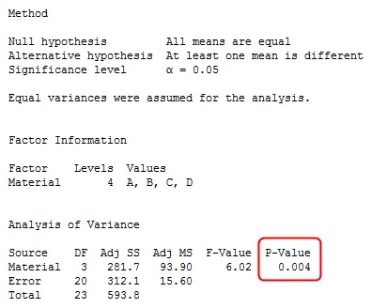
Strength study, ANOVA table
Figure 7. ANOVA table
Notes:
Here’s some output from Jim’s website. I think the program he is using is MINITAB, but the output from other packages will look very similar. The key statistic is the p-value, 0.004. Since this difference is small, you conclude that there is at least one pair of materials where there is a statistically significant difference in strength.

Slide 11
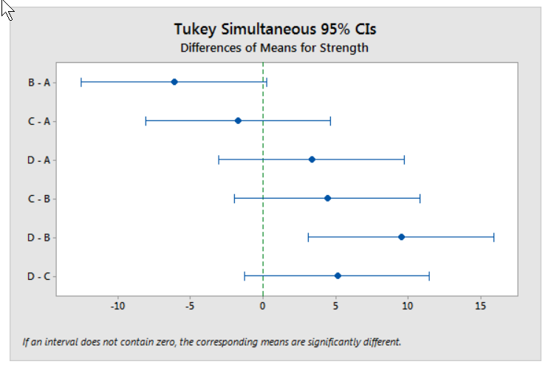
Strength study, post hoc comparisons
Figure 8. Graphical display of pairwise comparisons
Notes:
There are several approaches to identifying where the differences lie. Here’s a plot showing that the only statistically significant difference is between materials B and D.
This is a bit tricky to interpret. There is no statistically significant difference between the weakest material, B, and the second weakest, C. There’s no difference between C and the next material, A. And there is no difference between C and the strongest material, D.
But there is a difference between B and D. It seems a bit weird.
Perhaps the best analogy I can think of is that I live in Kansas City and I have relatives in Denver and Cincinnati. It’s not too bad a trip from Kansas City to Denver, and it’s not too bad a trip from Kansas City to Cincinnati. But it would be a significant trip to drive all the way from Denver to Cincinnati.
It just is an inherent ambiguity with the analysis of variance. Comparing pairs of means to see which pairs differ will sometimes provide unambiguous interpretations, but often they will not.
Now I don’t mean to harp on this point too much. ANOVA is a great technique. It often helps us greatly in understanding what is going on, in spite of these interpretation problems. But nothing is perfect in Statistics. There is at least some downside to everything that you try.

Slide 12
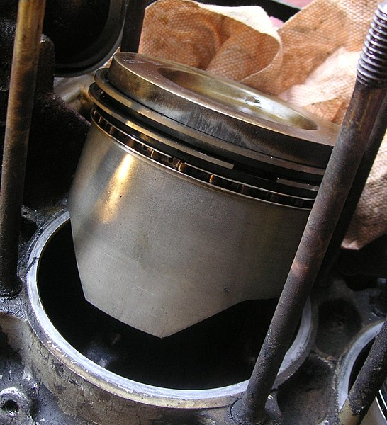
Illustrating control charts with piston ring measurements
Figure 9. Image of piston, cylinder, and piston rings for an automobile engine
Notes:
Here is an image from Wikipedia
https://commons.wikimedia.org/wiki/File:Piston_rings.jpg
of an automobile engine showing the piston, the cylinder it fits in, and the piston rings which insure a precise fit. With today’s engines, you need to size the piston rings very precisely, and if the manufacturing process starts to produce rings that are even just a tiny bit too small or too large, you end up with problems.

Slide 13
Piston ring, descriptive statistics (1/2)
Mean_diameter Stdev_diameter 1 74.010 0.015 2 74.001 0.008 3 74.008 0.015 4 74.003 0.009 5 74.003 0.012 6 73.996 0.009
Notes:
In this example, workers regularly monitor the diameters of the piston rings that they produce. It’s important to keep the diameters very very close to 74. The workers on the factory floor measure five diameters every day, compute the average and standard deviation for that day.
Here are those values for the first few days.

Slide 14
Piston ring, descriptive statistics (2/2)
Mean_diameter Stdev_diameter 35 74.013 0.012 36 74.004 0.013 37 74.017 0.007 38 74.020 0.011 39 74.023 0.009 40 74.013 0.012
Notes:
Around day 37 or 38, things start to go bad. 74.02 does not seem that much different than 74, but it is.

Slide 15
Control chart rules (1/2)
Plot the data in time sequence
Add control limits at 3 SIGMA
Out of control if:
One point outside of 3 SIGMA limits
Two out out three points outside of 2 SIGMA limits
Four out out five points outside of 1 SIGMA limits
Eight points on same side of center line
Notes:
For a control chart, plot the data in time sequence. This is important.
Add control limits at 3 SIGMA. I deliberately use the term SIGMA because it is not actually a standard deviation across all of the data. SIGMA represents short term variation. There are several ways to compute short term variation, but it is never a straight standard deviation.

Slide 16
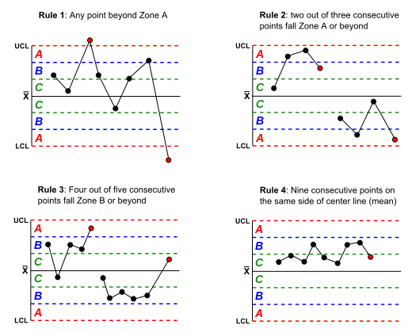
Control chart rules (2/2)
Figure 10. Illustration of control chart rules
Notes:
Here’s a graphical illustration of these rules, taken again from the font of all wisdom, Wikipedia.
https://commons.wikimedia.org/wiki/File:Western_electric_rules.svg

Slide 17
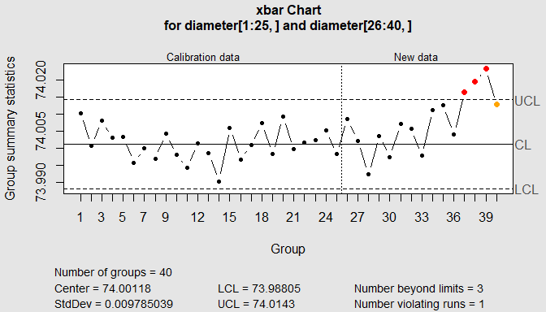
Piston ring, control chart

Slide 18
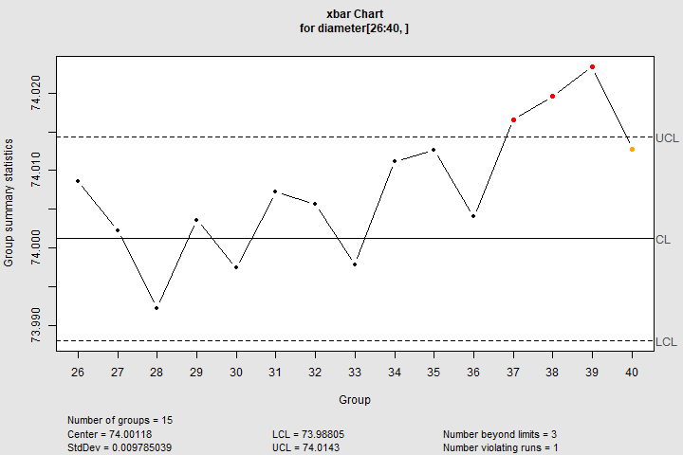
Figure 11. Graph of control chart
Notes:
This slide shows an example of a control chart for the piston ring data. It shows trouble starting on day 37.

Slide 19

A mining illustration
Figure 12. Seven dwarves from Snow White
Notes:
Here is a hypothetical example, looking at the mining output of a famous group of miners. Can anyone name all seven dwarfs?

Slide 20
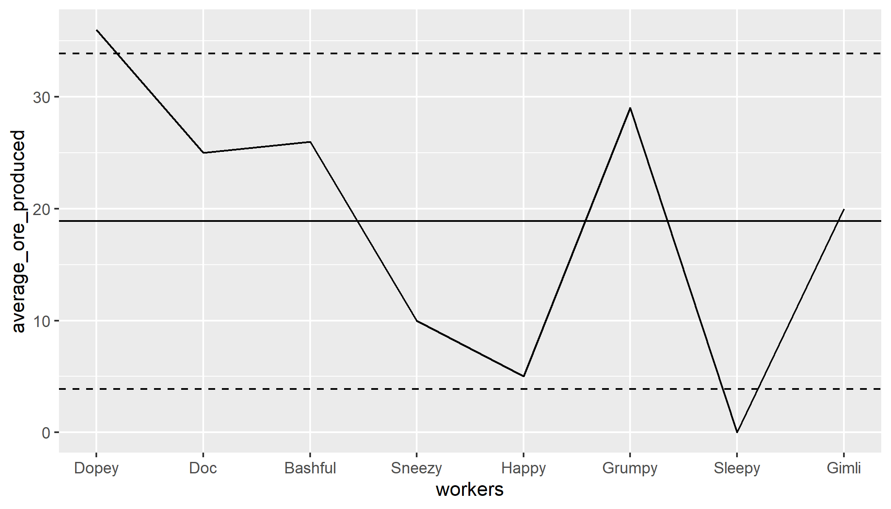
A common mistake for control charts
Figure 13. Inappropriate control chart
Notes:
Here’s a fictional chart showing ore production by eight dwarves. I added an eight dwarf. Does anyone know who “Gimli” is?
This is drawn like a control chart and uses control chart limits, but it is not a correct application of control chart methodology.

Slide 21
Why is this control chart bad?
Worker chart has an arbitrary order
Control charts rules depend on a time sequence
Rules optimized for average run length
Use ANOM chart instead
Notes:
Most of the decision rules such as
Eight consecutive points on same size of the center line
Two out of three outside two sigma limits
Four out of five outside one sigma limits
are dependent on the ordering of the data.
But the ordering shown in the previous chart is arbitrary. You could have just as easily arranged the dwarfs names alphabetically and you would end up with the possibly a different interpretation.

Slide 22
Stop here if there are questions
What you’ve seen
Review
ANOVA
Control charts
What’s coming up
Framework for Analysis of Means

Slide 23
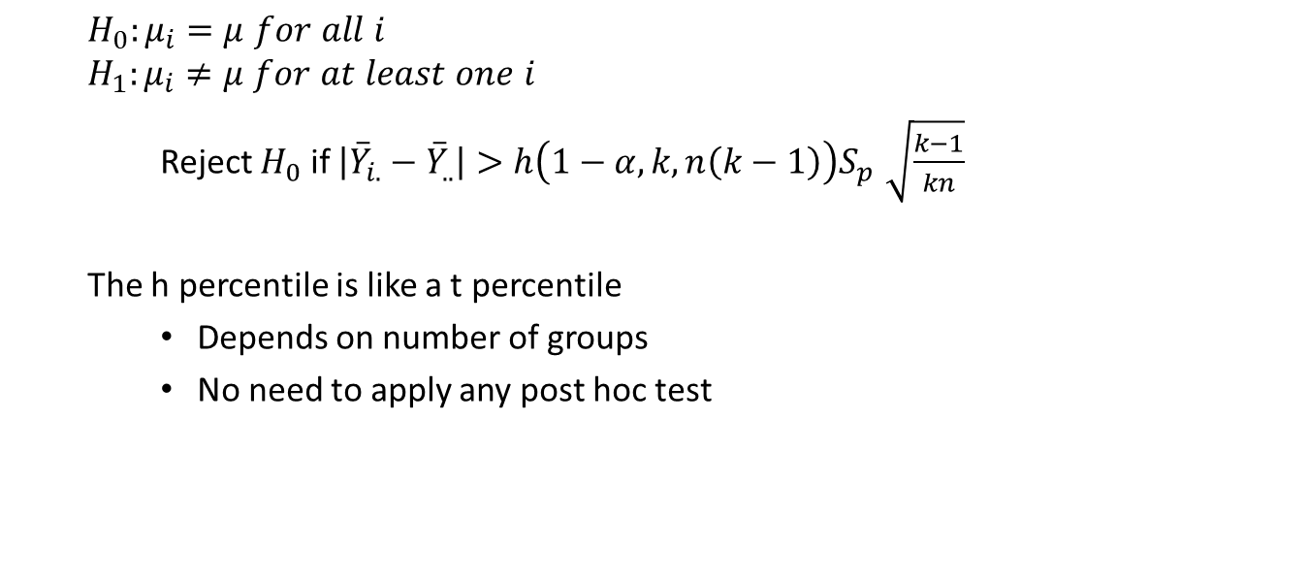
The ANOM hypothesis
$$H_{0}:μ_{i}=μ for all i$$
$$H_{1}:μ_{i}≠μ for at least one i$$
Reject $H_{0}$ if $\left|{\overset{‾}{Y}}_{i.}−{\overset{‾}{Y}}_{..}\right|>h\left(1−α,k,n\left(k−1\right)\right)S_{p}\sqrt{\frac{k−1}{kn}}$
The h percentile is like a t percentile
Depends on number of groups
No need to apply any post hoc test
Notes:
This is the Analysis of Means hypothesis. I’m keeping things simple by assuming that there ar exactly lower-case n values in each of k groups.
You are comparing each mean to the overall mean. This is a slightly different approach than looking at pairs of means, as Analysis of Variance does.

Slide 24
ANOM table
k=2 3 4 5 6 df=2 4.30 5.88 6.59 7.10 7.49 3 3.18 4.18 4.60 4.92 5.14 4 2.78 3.56 3.89 4.12 4.30 5 2.57 3.25 3.52 3.72 3.88 6 2.45 3.07 3.31 3.49 3.62 7 2.36 2.94 3.17 3.33 3.46 8 2.31 2.86 3.06 3.22 3.33
Notes:
You need percentiles from a special distribution. You can find tables for this distribution in many places. Here’s a small piece of a table that I produced a while back. You can find the full table at
http://www.pmean.com/07/AnomTable05Part1.html
and
http://www.pmean.com/07/AnomTable05Part2.html
If you are curious, here are a few details about how I generated this table. I cross checked it against several other tables, by the way.
You compute the critical value using a multivariate t-distribution. There are a few complications. First the distribution you are trying to describe represents deviations from an overall mean, so there will be correlations in the data since each group contributes to the overall mean. This correlation, -1/(I-1), is the same for any pair of deviations. Second, the sum of the deviations must equal zero, so this produces a degenerate distribution. This degeneracy means that there is no inverse for the correlation matrix.
In R, there is a library, mvtnorm, that will allow you to compute the percentiles needed for ANOM. Here’s an example to get h(0.95, 5, 15):
i <- 5
co <- matrix(-1/(i-1), nrow=i, ncol=i)
diag(co) <- rep(1,i)
qmvt(p=0.95, tail=“both.tails”, corr=co, df=15)

Slide 25
Stop here if there are questions
What you’ve seen
Framework for Analysis of Means
What’s coming up
A simple example

Slide 26

Label placement
Figure 14. Six labeled bottles of bourbon

Slide 27
Label placement, descriptive statistics
position avg stdev 1 1 -0.022 0.023 2 2 0.016 0.033 3 3 0.006 0.029 4 4 0.065 0.021 5 5 0.008 0.026 6 6 -0.013 0.016
Notes:
This data set comes from the SAS QC Guide. It represents deviations in label placement for a bottling machine. There are six different positions for this machine, and you want to find out if the deviations are substantially different for one or more positions.
Here are the means and standard deviations for each position.
It looks like positions 1 and 6 are a bit too low, position 4 is a bit too high, and positions 2, 3, and 5 are somewhere in between. Do any of these differ from the overall mean?

Slide 28
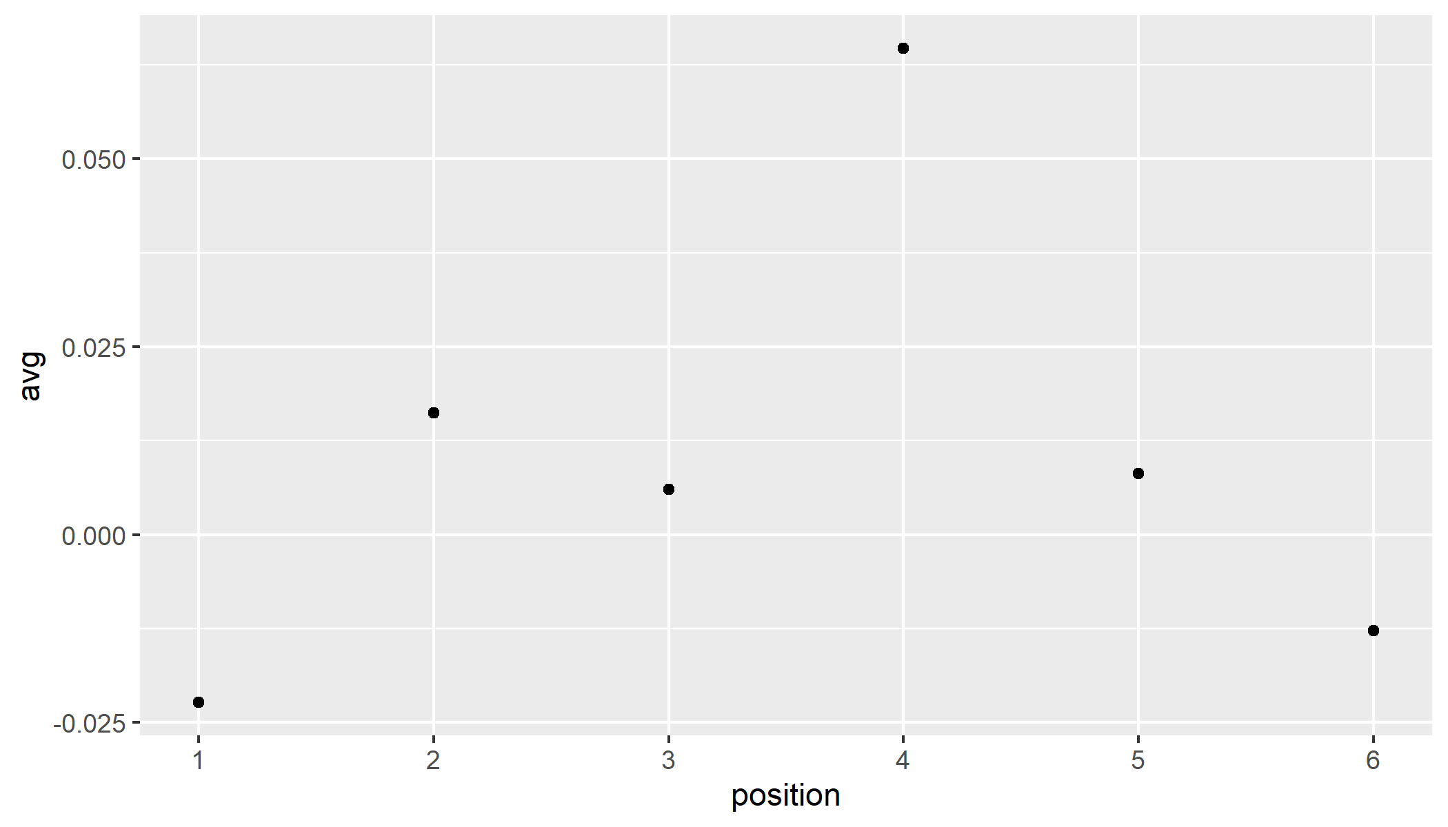
Label positions, Preliminary graph of means
Figure 15. Plot of mean label position
Notes:
A plot of the position means shows a bit more clearly the pattern I mentioned earlier.

Slide 29
Label positions, overall mean and pooled standard deviation
avg sp 1 0.01 0.025
Notes:
The overall mean and the pooled standard deviation are computed used the standard formulas you learned in your STATS 101 class.

Slide 30
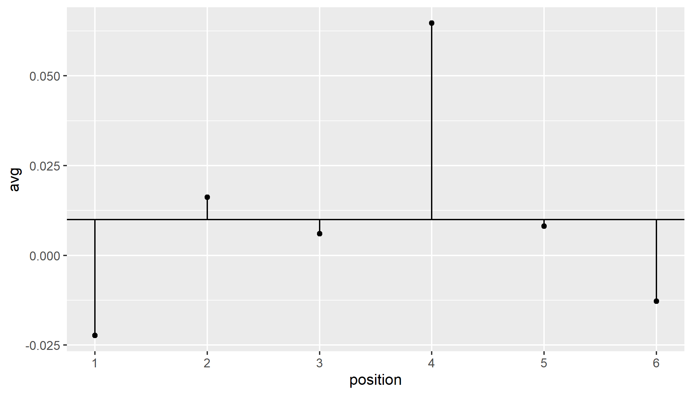
Label positions, deviation from overall mean
Figure 16. Plot of deviations from overall mean
Notes:
Draw a horizontal line at the overall mean and show the deviations from the overall mean as spikes.

Slide 31

Label positions, calculate ANOM limits
$${\overset{‾}{Y}}_{..}±h\left(1−α,k,n\left(k−1\right)\right)S_{p}\sqrt{\frac{k−1}{kn}}​$$
0.01 $±$ 2.72 0.025 $\sqrt{\frac{5}{60}}$
-0.01 to 0.03
Notes:
Here is the calculation of limits. Anything outside these limits is statistically significantly different than the overall mean.

Slide 32
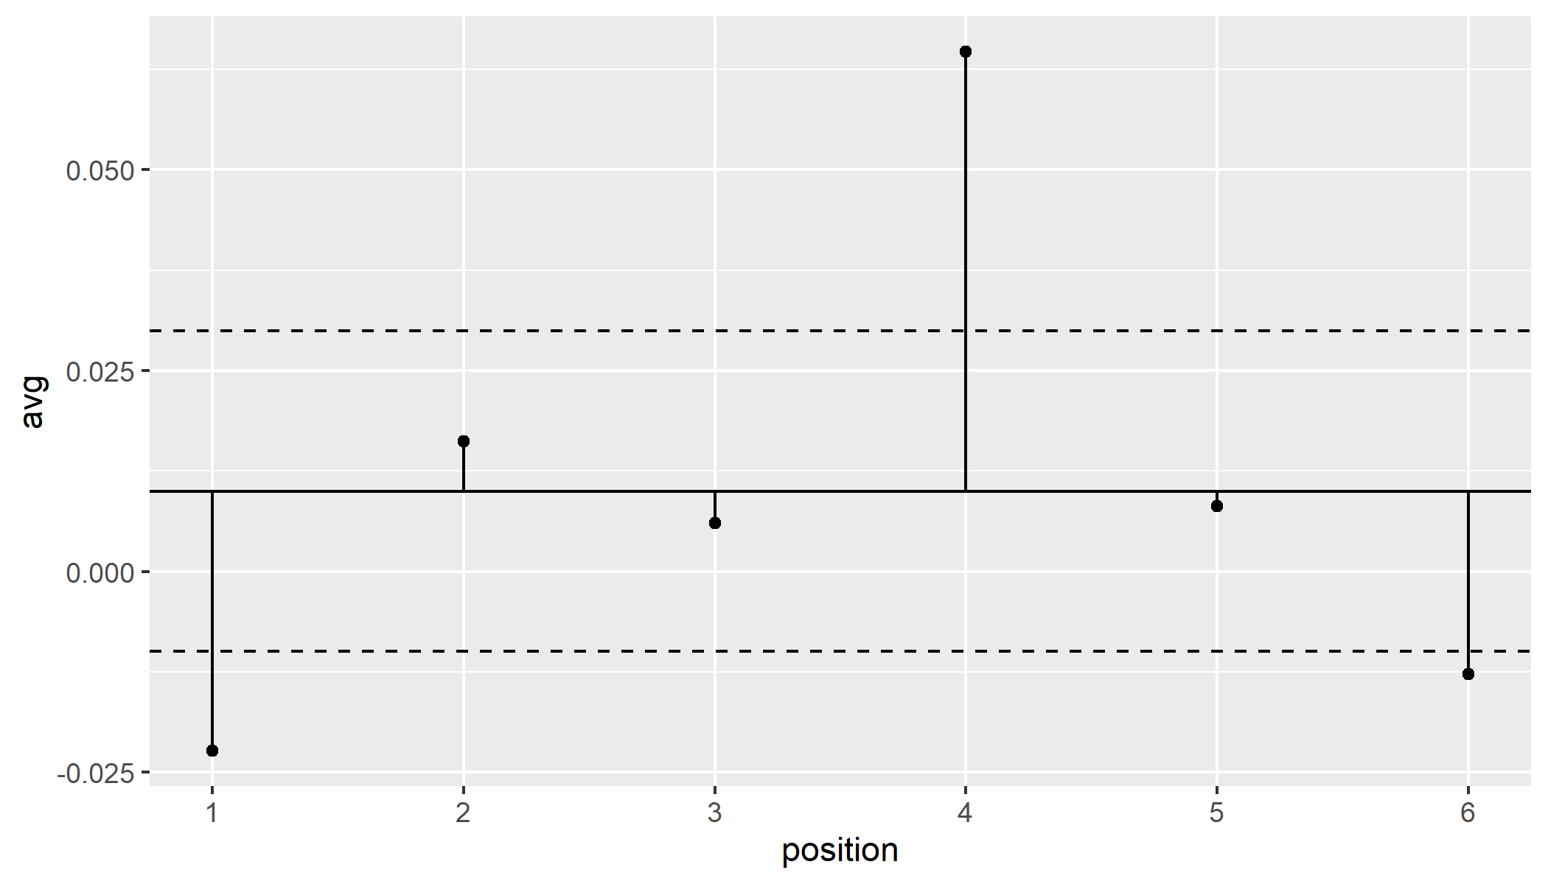
Label positions, add limits to graph
Figure 17. Plot with ANOM limits
Notes:
Here is the graph with the analysis of means limits. Your intuition was correct. There are significant deviations to the left in positions 1 and 6 and a significant deviation to the right in position 4.
Now, why would we compare to the overall mean rather than to zero? It depends on the context, but on these assembly lines, there are adjustments that you can make to change the positioning of labels across all positions, and those adjusted will never help you here. Because any overall change to the labels is either going to make positions 1 and 6 worse, or position 4 worse. You need to make interior adjustments rather than global adjustments.

Slide 33
Stop here if there are questions
What you’ve seen
A simple example
What’s coming up
Extensions to proportions and counts

Slide 34

C-sections
Figure 18. Image of newborn infant
Notes:
An example involving means rather than proportions can also be found in the SAS QC guide.
A large health care system is examining the rate of C-section births at various locations. All the locations work with low risk births and (in an ideal world) should have the same probability for a C-section birth.
There are a gazillion pictures of newborn infants on the Internet. This image is taken from Wikipedia. By the way, aren’t you glad I didn’t show the baby DURING the C-section delivery.
https://commons.wikimedia.org/wiki/File:Sleeping_newborn_infant.jpg

Slide 35

Analysis of means for proportions
Two changes
Proportions rather than means
Unequal group sizes
Limits
$\overset{‾}{p}±m\left(1−α,k,∞\right)\sqrt{\overset{‾}{p}\left(1−\overset{‾}{p}\right)}\sqrt{\frac{N−n_{i}}{Nn_{i}}}$
IMPORTANT!!! Limits change with i
Notes:
There are several possible extensions of the Analysis of Means model. A very interesting one appears in the same SAS reference. It involves a comparison of the probability of C-section births among a variety of different clinics.
You can use the normal approximation to the binomial distribution and instead of a pooled variance, you use the square root of p-bar times one minus p-bar.
The other extension is the unequal sample sizes. Some clinics only had 3 total births during the study time frame, and one clinic had almost a thousand births. You have to use a different table for unequal sample sizes. I don’t have easy access to this table, but you can find it in a book by Nelson.
Peter R. Nelson, Peter S. Wludyka, Karen A. F. Copeland. The Analysis of Means. A Graphical Method for Comparing Means, Rates, and Proportions. ASA-SIAM Series on Statistics and Probability. Siam, Philadelphia PA, ASA, Washington DC, 2005.
VERY IMPORTANT!!! There is a subscript i in this equation. That means that the limits vary in width. That’s to be expected when you have unequal sample sizes.

Slide 36
C-sections, first six observations
group c_sections births prob 1 1A 150 923 0.16 2 1K 45 298 0.15 3 1B 34 170 0.20 4 1D 18 132 0.14 5 3I 20 106 0.19 6 3M 12 105 0.11
Notes:
You can also use the analysis of means methods for proportions and counts. Here’s an example of some proportion data.

Slide 37
C-sections, last six observations
group c_sections births prob 24 3G 1 11 0.09 25 1L 2 10 0.20 26 1I 1 8 0.12 27 1P 0 3 0.00 28 1F 0 3 0.00 29 1S 1 3 0.33

Slide 38
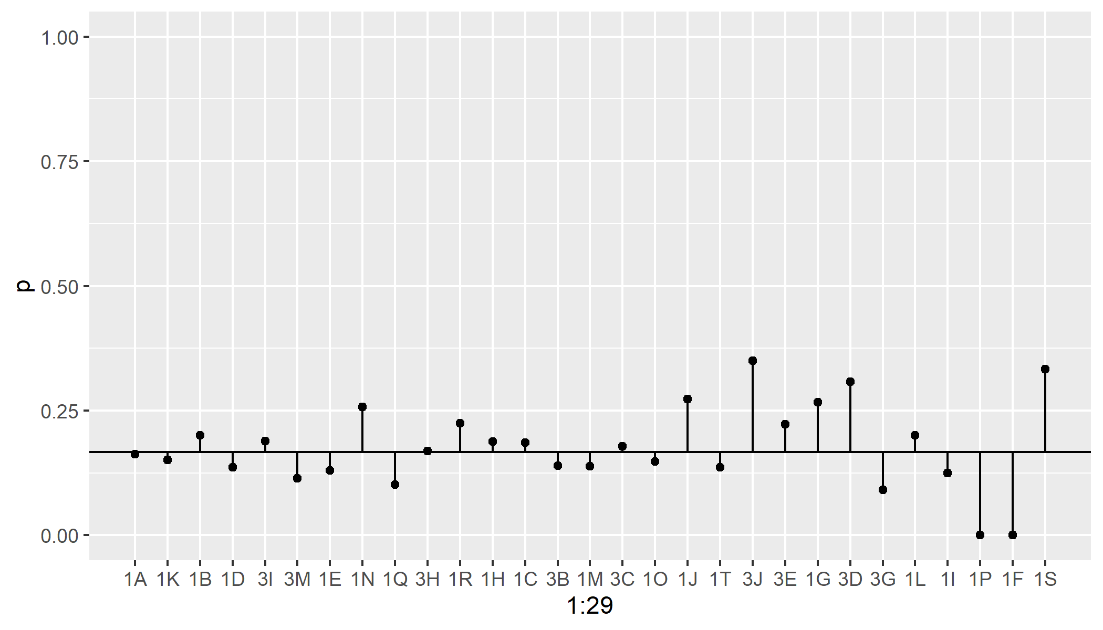
C-sections, preliminary plot
Figure 19. Plot of C-section proportions
Notes:
Here is a plot of the proportions. It looks like there are substantial deviations from the overall C-section rate, but here your initial intuition, if it was like mine, is incorrect.

Slide 39
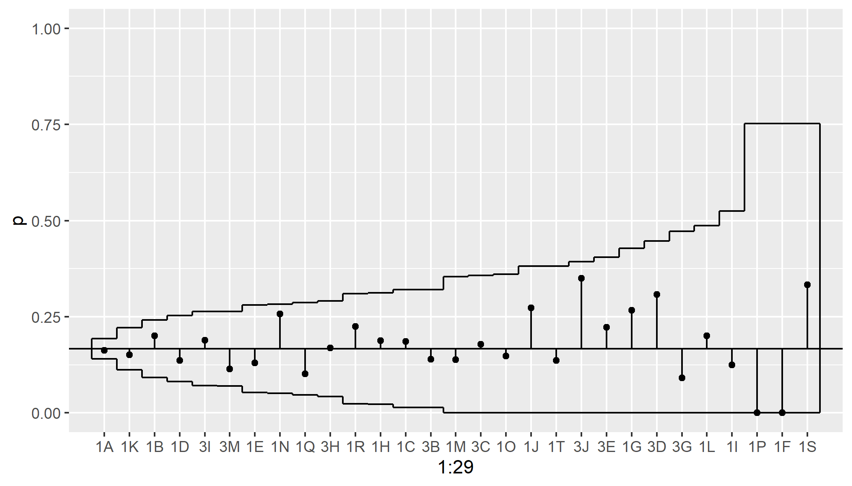
C-sections, plot with ANOM limits
Figure 20. Plot of C-secton proportions with ANOM limits
Notes:
I won’t show the actual calculations here, but they are tedious rather than difficult. Notice the the clinics with more births (the ones on the left) have narrower analysis of means limits than the clinics with fewer births (the ones on the right). But all the points are within the

Slide 40
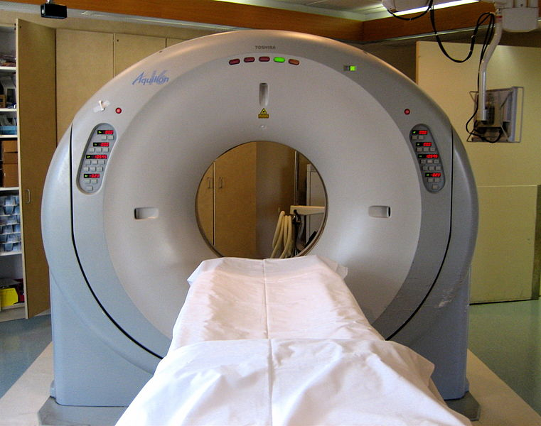
CAT scans
Figure 21. Image of CAT scan machine
Notes:
The last example is a comparison of rates of utilization of CAT scan machines. These machines are very expensive, and the hospital system wants to make sure that they are not being under-utilized for economic reasons. Over-utilization is also a problem, as it indicates that this diagnostic tool is being used too often and, perhaps, inappropriately.

Slide 41
Cat scans, raw data
cat_scans members rate 1 50 26.838 1.86 2 71 26.895 2.64 3 41 26.142 1.57 4 62 25.907 2.39 5 89 26.565 3.35
Notes:
One last example. This example is taken from page 46 of a book by Nelson, Wludyka, and Copeland. CAT scans are done at five different clinics. Each clinic serves a different number of members.

Slide 42
CAT scans, overall rates
There are 313 CAT scans and 132.347 thousand members across all clinics, providing an overall rate of 2.36 scans per thousand patients.

Slide 43
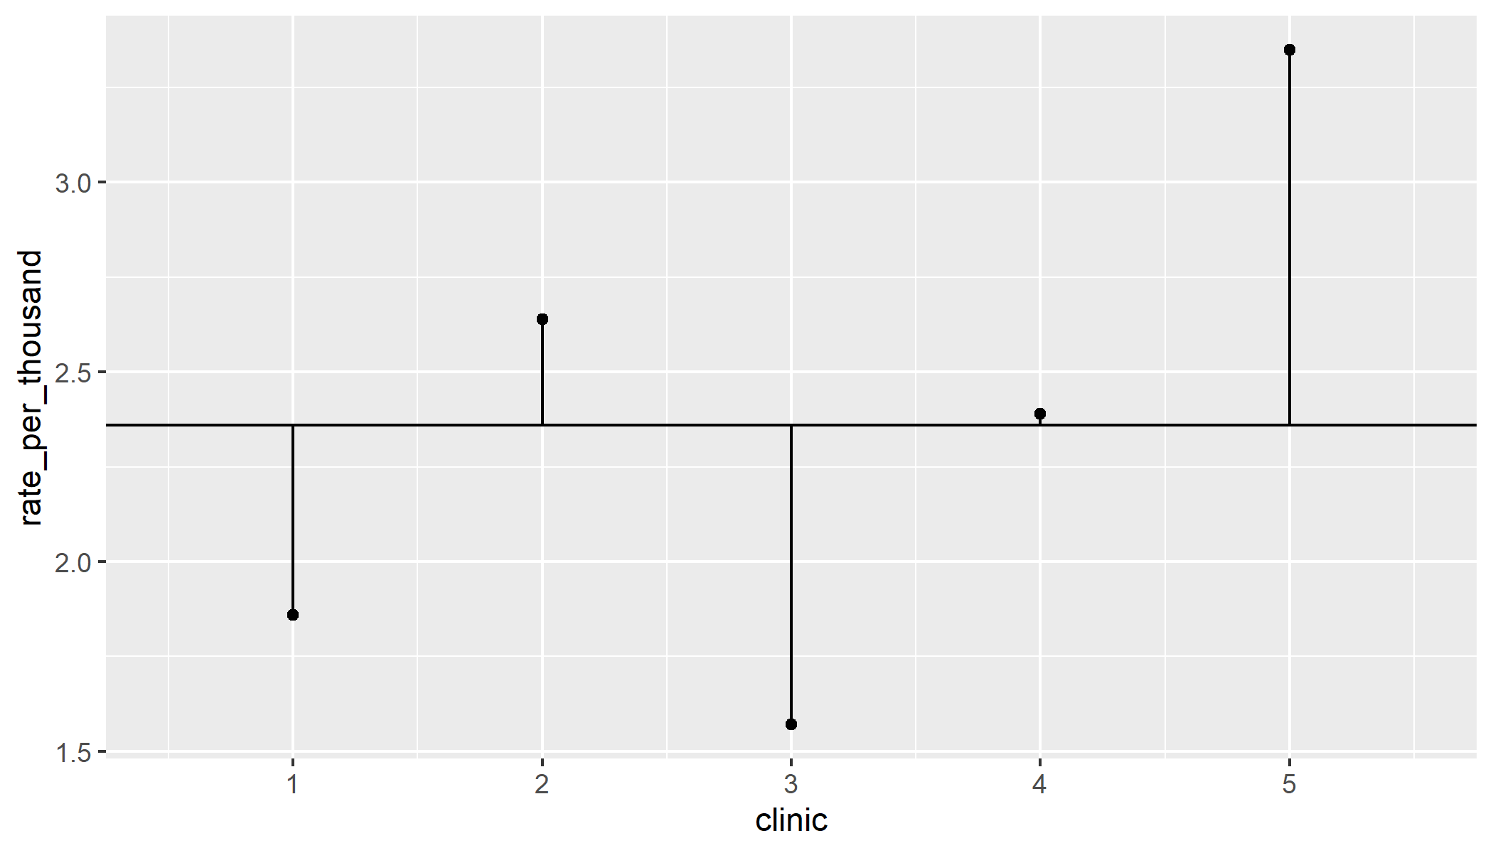
CAT scans, plot of rates
Figure 22. Plot of CAT scan utilization rates
Notes:
Here are the plots of CAT scan rates. Notice that clinics 1 and 3 have lower rates. Clinics 2 and 5 have higher rates.

Slide 44
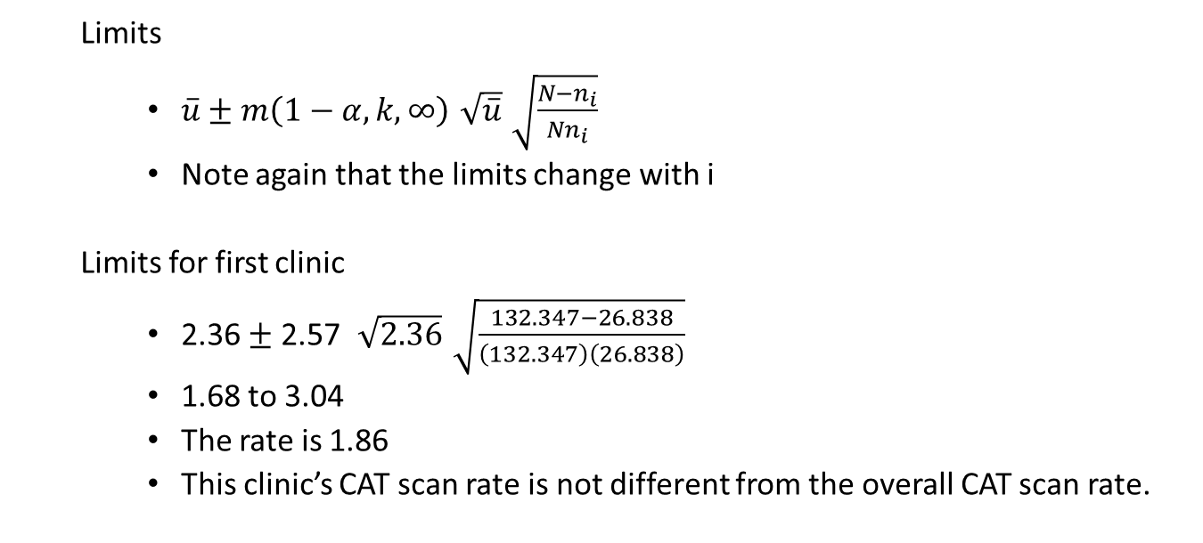
Analysis of means for rates
Limits
$\overset{‾}{u}±m\left(1−α,k,∞\right)\sqrt{\overset{‾}{u}}\sqrt{\frac{N−n_{i}}{Nn_{i}}}$
Note again that the limits change with i
Limits for first clinic
2.36 $±$ 2.57 $\sqrt{2.36}\sqrt{\frac{132.347−26.838}{\left(132.347\right)\left(26.838\right)}}$
1.68 to 3.04
The rate is 1.86
This clinic’s CAT scan rate is not different from the overall CAT scan rate.
Notes:
Here are the formulas. Notice that where we formerly had the pooled standard deviation or the square root of p-bar time 1-pbar, now we have the square root of u-bar. This is because the variance of a Poisson random variable is equal to its mean. Thus the standard deviation of a Poisson random variable is equal to the square root of its mean.
The formulas here are very similar to control limits on a C-chart or a U-chart.

Slide 45
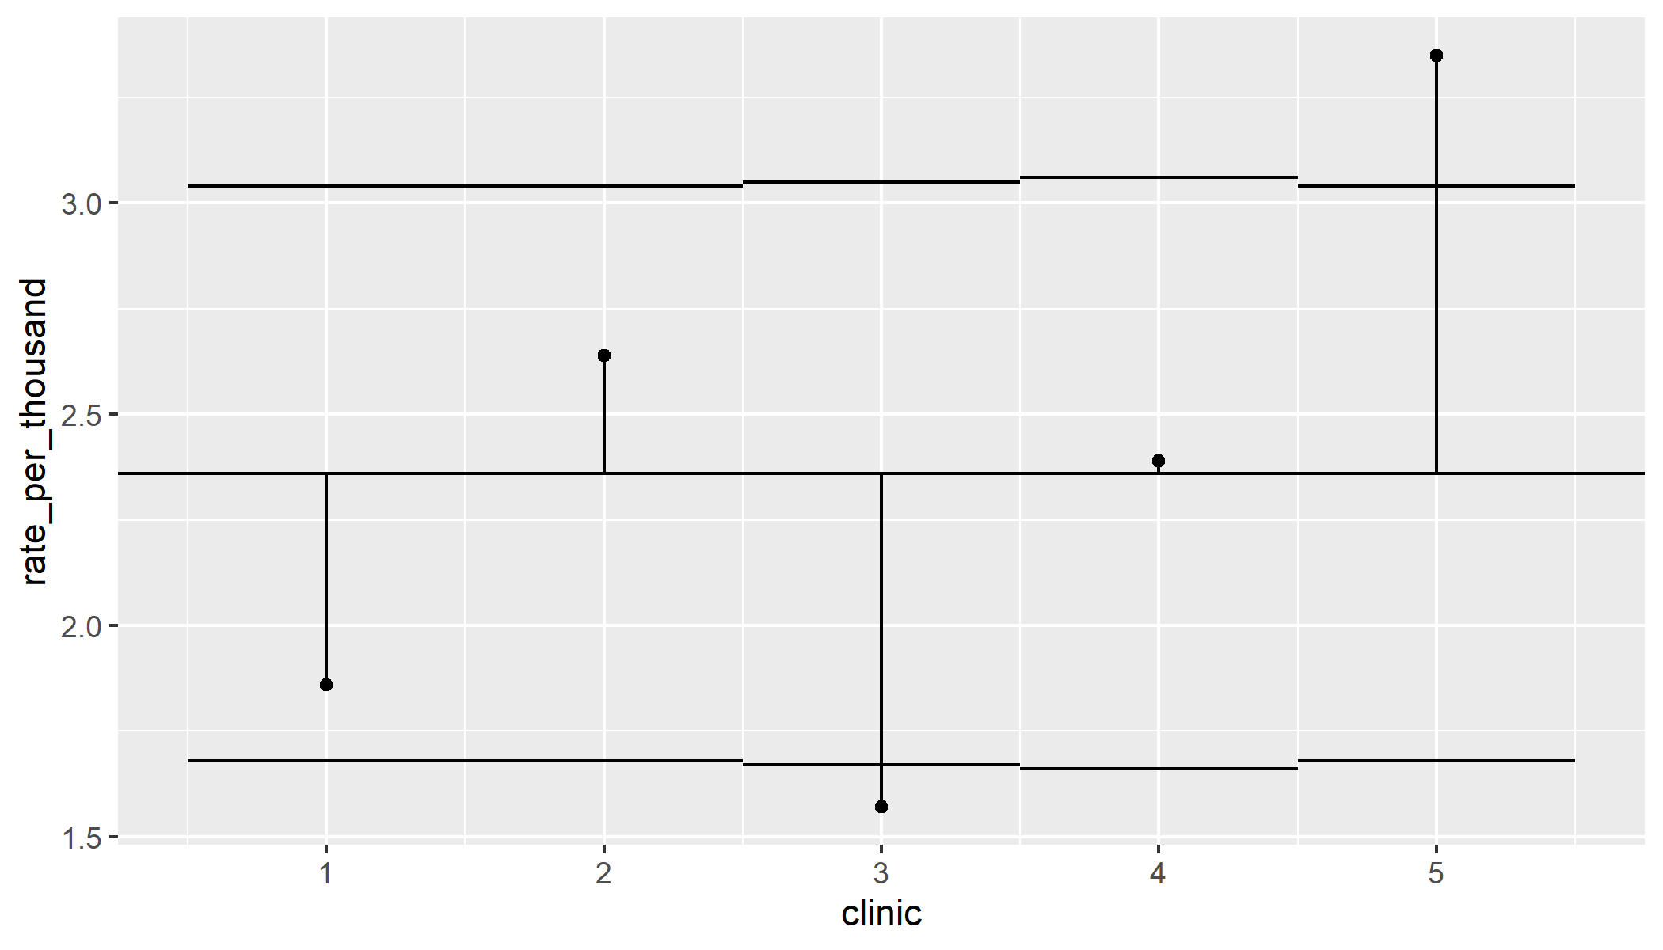
CAT scans, display with ANOM limits
Figure 23. Plot of CAT scan utilization rates with ANOM limits
Notes:
Here are the plots with analysis of means limits. The limits are slightly different because the clinics did not have the same number of members. But the differences in the limits are minor. Clinic 3 has a lower rate of CAT scan utilization compared to the overall rate and Clinic 5 has a higher rate of CAT scan utilization.

Slide 46
Stop here if there are questions
What you’ve seen
Extensions to proportions and counts
What’s coming up
Other extensions
How to interpret
Contraindications

Slide 47
Other extensions of ANOM
ANOM using the range instead of the standard deviation
Multifactor studies
Nonparametric approaches
Testing variances
Notes:
If you look for applications of analysis of means in the peer reviewed literature and on the web, you’ll see some advanced applications. I am not a big fan of these extensions, but perhaps that is just because I have not had a chance to work with them.
Donald Wheeler has developed the analysis of means methodology that uses ranges rather than variances to calculate the limits. This has some appeal to simplicity, as you can calculate a range a lot faster than you can calculate a standard deviation. There is some loss in efficiency, however, by using ranges.
Other applications look at multi-factor settings, and you can run analysis of means charts for main effects and interactions. Most example I have seen only have a small number of levels for each factor, and these examples don’t seem to offer much beyond what traditional analysis of variance can already do. It may have more applications in searching for which combinations of factors lead to an interaction.
There are also several nonparametric approaches. Analysis of means does rely on an assumption of normality, but with small sample sizes and skewed data, this can sometimes be problematic.
Another extension is the use of analysis of means to look for groups that have much larger or much smaller variances. You could use this as a check on the homogeneity assumption for an upcoming analysis of variance, but there are already plenty of good tests out there. Further, there is controversy over how you should test for homogeneity or even if you should test for homogeneity. A better application might be examining a process where the mean level is not important, but it is important to have consistency around whatever mean you might have.

Slide 48
How to handle results
Negative result implies consistency
But is it consistently bad?
Work on global changes
Positive result implies inconsistency
“If you can’t be a good example, then you’ll just have to be a horrible warning”
Work on local changes
Similar advice on control charts
Notes:
The previous example showed a negative result. None of the C-section proportions was statistically significant. Every group was average.
Boring!
Well, maybe not. If the different medical groups had a similar mix of pregnancies and yet some had significantly higher probabilities for C-sections, then either the groups with the higher probabilities are doing something wrong, or everyone else is doing something wrong.
There is often too much inappropriate variation in the delivery of health care. A negative finding here says that this is not an issue with regard to C-section rates among the varying clinics.
What if you do see one or more statistically significant deviations from the overall average?
There’s a well known quote from Catherine Aird, a famous English novelist. Think of the groups that are significantly above average (assuming that larger is better) as shining examples to be emulated. Study what is different about these groups that makes them perform so well. Can other groups learn from their experience.
Think of the groups that are significantly below average as the horrible warnings. Study what is different about these groups, so that you can improve them and/or so that you can avoid those problems in the other groups.
The point to both of these is that any future steps that you take should be local.

Slide 49
ANOM contraindications
Simplicity comes with a price
You should not use ANOM
when searching for the best group
when comparing to a control group
for a reward or punishment system
Notes:
You should avoid ANOM in certain settings.
It does not help when you want to identify the best among a group. There would be three or four groups that are all above average, but maybe they are all about the same or maybe one is head and shoulders above the others. Analysis of means cannot distinguish between these very different scenarios.
Pairwise comparisons work well when you are searching for the best. There is also a Bayesian approach that runs repeated simulations of the posterior distribution, ranks the estimated group means, and then estimates the proportion of times that a given group gets the number 1 rank in the simulation.
If there is a control group, your interest should be in deviations from the control group rather than deviations from an overall average. The Dunnett’s post hoc comparison in an ANOVA model works well here.
Finally, and possibly the most important point is about rewards and punishments. There is an unfortunate tendency in many workplaces to blame all the quality problems on the workforce. In fact, it is the system that people work in that is most often deserving of blame.
If you use Analysis of Means (or any statistical approach, for that matter) to decide who gets bonuses and who gets fired, you’re making a big mistake.
An unusual result for an individual or for a particular work group becomes the start of an investigation. Mindlessly offering rewards and punishments short-circuits the thinking process. I’m not saying that workers are never to blame. I just worry that statistics make it too easy to jump to conclusions.

Slide 50
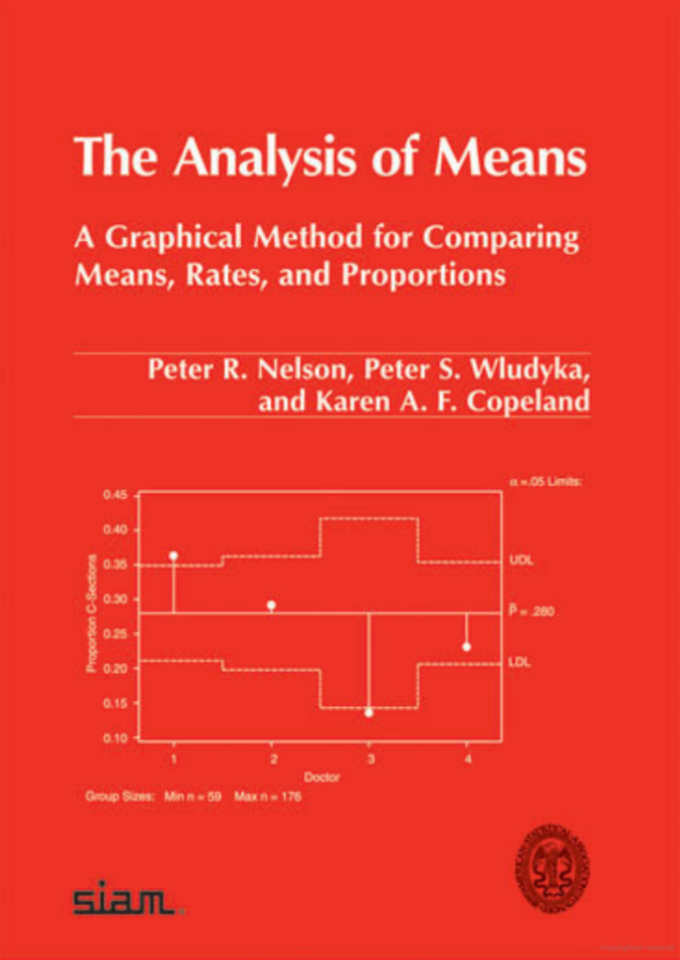
Resources, Nelson et al
Figure 24. Front cover of Nelson et al
Notes:
The book
Peter R. Nelson, Peter S. Wludyka, Karen A.F. Copeland. The Analysis of Means. A Graphical Method for Comparing Means, Rates, and Proportions. ASA-Siam Series on Statistics and Applied Probability. Siam, Philadelphia PA, ASA, Alexandria VA, 2005.
has everything you need including most of the extensions discussed earlier.

Slide 51

Resources, SAS
Figure 25. Front cover of SAS manual
Notes:
SAS put all its documentation online a couple of decades ago, and it is a great resource, even if you don’t use SAS. This is the front “cover” of the documentation for PROC ANOM, and it is available at
https://support.sas.com/documentation/onlinedoc/qc/142/anom.pdf
My only complaint is that they did too much. The entire manual is 160 pages. About 25% of the content is general tutorials on the methodology itself and not SAS specific.

Slide 52
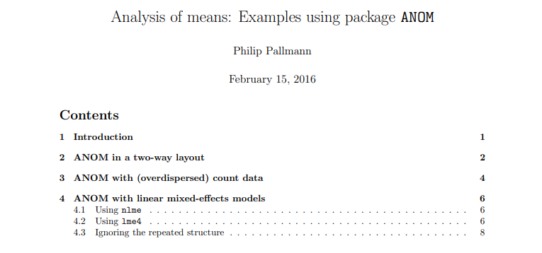
Resources, R
Figure 26. Front page of R vignette on ANOM
Notes:
The quality of documentation in R is uneven, but any package that comes with a vignette is almost always well documented. A vignette is a document showing a few simple examples of how to use an R package and interpret the output. The vignette for the R package ANOM actually starts with some advanced examples, but you will find references in this vignette by the same author covering more basic examples.
https://cran.r-project.org/web/packages/ANOM/vignettes/ANOM.pdf

Slide 53
Conclusions
ANOM compares each group mean to the overall mean
It can be applied for proportions or counts as well
It has a simple interpretation
It has a simple graphical display
Useful for some but not all research settings
Questions?

